Slide 1
Sound

Slide 2

Today's lesson objectives
Split and duplicate a selected part of the audio
Use the Fade In and Fade Out effects
Change the speed and tempo of audio
Reverse audio
Download audio from YouTube

Slide 3
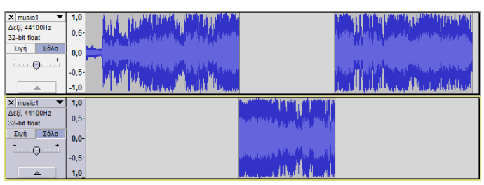
Split
Split: divides a track into independent audio clips.
If an audio track contains several sections that we want to edit independently, such as several songs on the same track, we can separate them with the Split tool.
Edit -> Audio Clips -> Split
Edit -> Audio Clips -> Split New
The selected audio is split and moved to a new track.

Slide 4
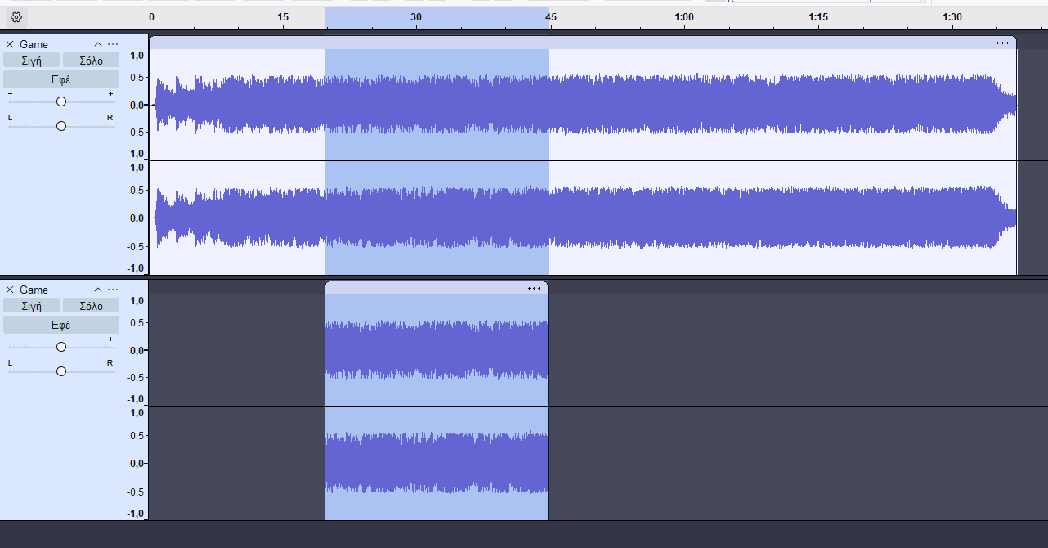
Duplicate
A copy of the selected audio at the same point in time as the original, but on another track.
After selecting the section we want to duplicate,
choose Edit -> Duplicate from the menu.

Slide 5
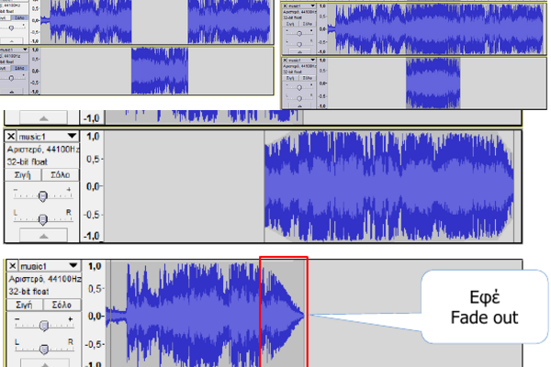
Fade Out – Fade In
Combine them for a smooth transition between two songs.
First select the section, then apply the effect.
Fade Out: the volume gradually decreases to silence (Effect -> Fade Out).
Fade In: the volume gradually increases from silence (Effect -> Fade In).
Notes:
[Sources]
- pliroforiki_a_lykeiou_simeioseis_2023_2024(1).pdf, σελ. 74

Slide 6
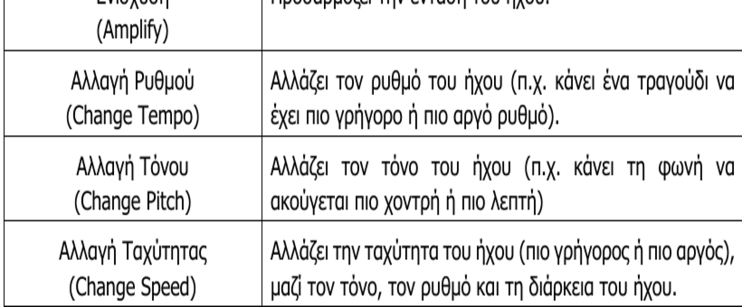
Audio modification effects
Change Speed: changes speed, pitch, tempo and duration.
Change Tempo: changes the tempo without changing the pitch.
Reverse: plays the audio backwards.
Notes:
[Sources]
- pliroforiki_a_lykeiou_simeioseis_2023_2024(1).pdf, σελ. 75

Slide 7
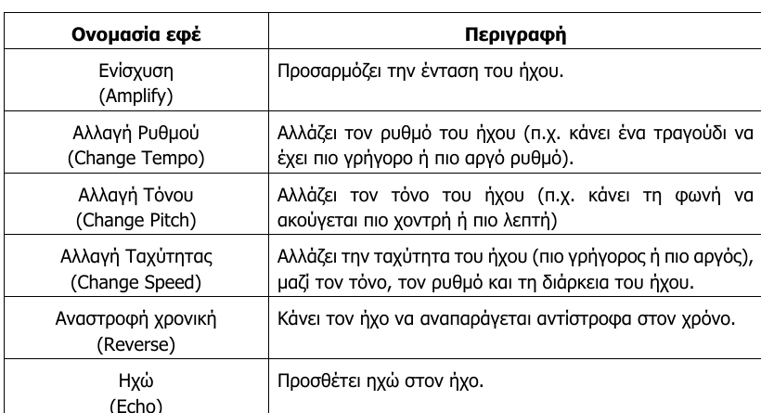
Various effects
Notes:
[Sources]
- pliroforiki_a_lykeiou_simeioseis_2023_2024(1).pdf, σελ. 74

Slide 8

Exercises
In class (Notes, pages 51–66)
1, 2, 3, 4 (pages 45–46)

